Slide 1
Formation of the planets layers/differentiation
Sources of heat for planets
4 Surface Planets
Martian Geology
Venusian Geology (inc water on Mars and Venus)

Slide 2
Planetary Surfaces
Of the Rocky Planets

Slide 3
Recap
When a planets moon is in a prograde orbit that means what?
Which rocky planet has the largest core for its size?
Which gas giants have rings?

Slide 4
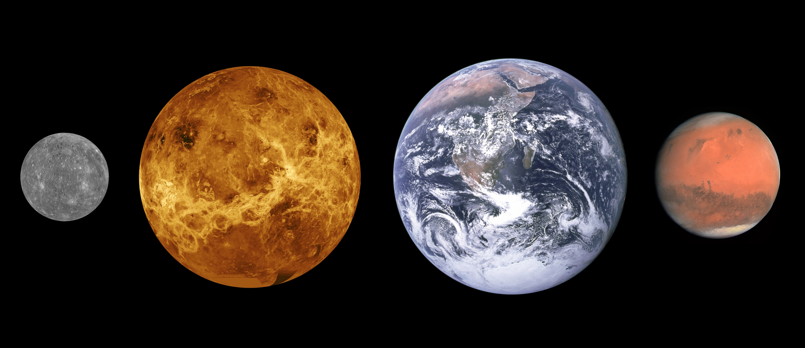
The Rocky Planets
Notes:
Mercury image: NASA/JHUAPL Venus image: NASA Earth image: NASA/Apollo 17 crew Mars image: ESA/MPS/UPD/LAM/IAA/RSSD/INTA/UPM/DASP/IDA
Scales are roughly correct, distances between them not so much.

Slide 5
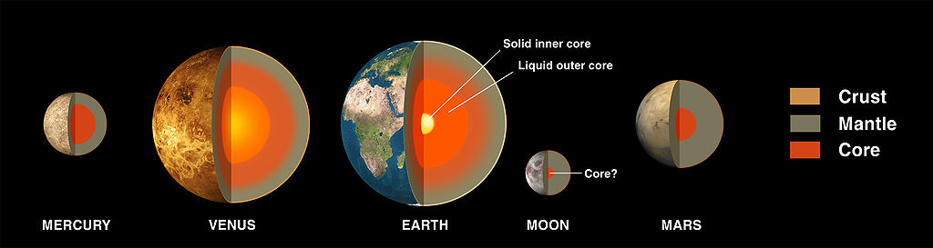
Molten Start
The planets when they formed where molten (at least partially).
This lead to a process called differentiation where materials separate according to density with denser materials at the centre of the planet. This is why the rocky planets have dense iron cores and less dense rocky mantles and crusts.
NASA/Wikimedia
Notes:
Explain differentiation – planets that spent longer in the molten state differentiated more!

Slide 6
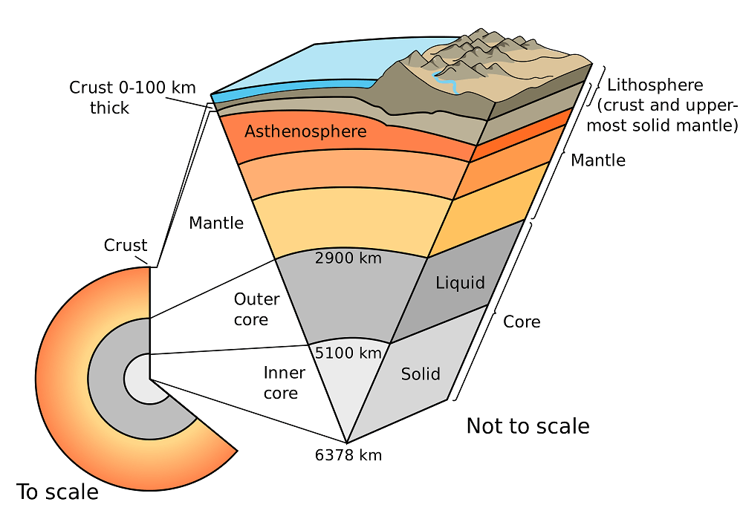
Earth’s Complex Insides
pubs.usgs.gov
Notes:
Wow! Compositional layers left – mechanical right

Slide 7
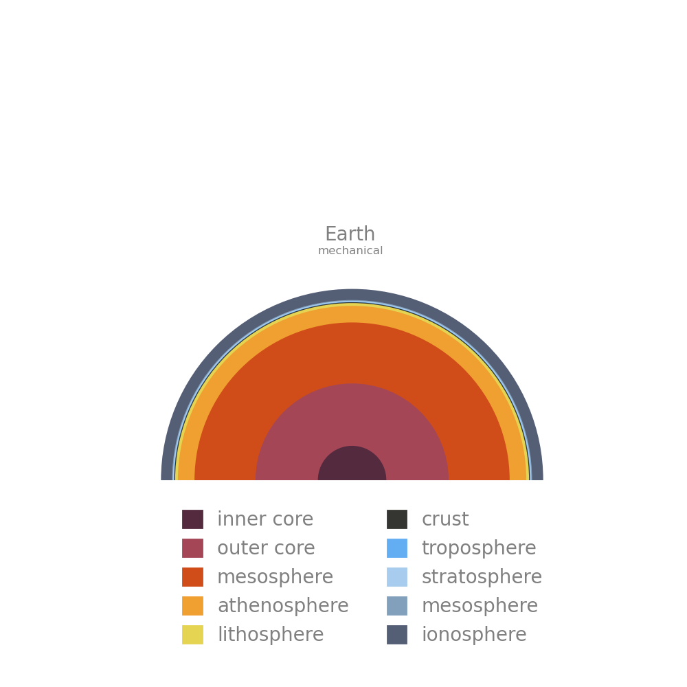
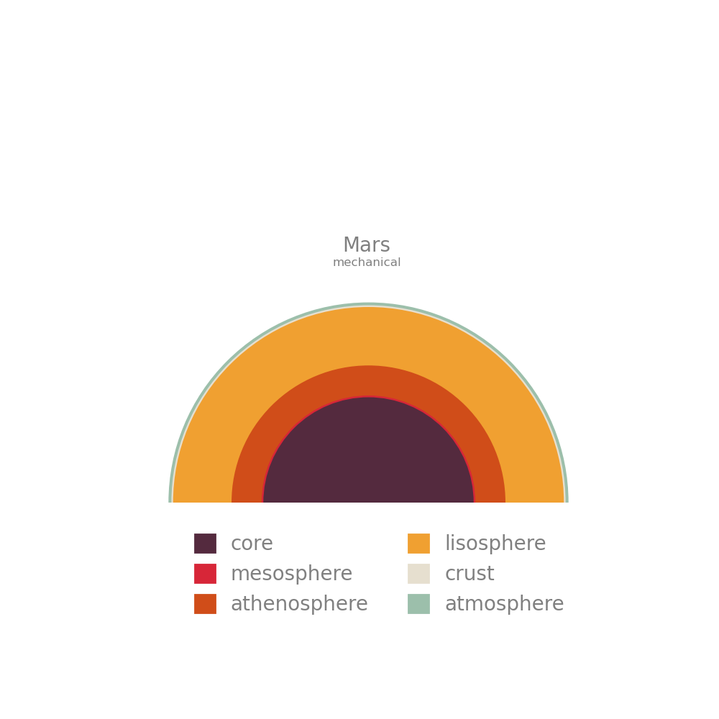
Lithospheres
Notes:
Mars has a huge solid lithosphere limiting Geological activity
Earth and Venus have smaller lithospheres of roughly the same size.
Mercury has all lithosphere no Mantle (too small and cold)

Slide 8
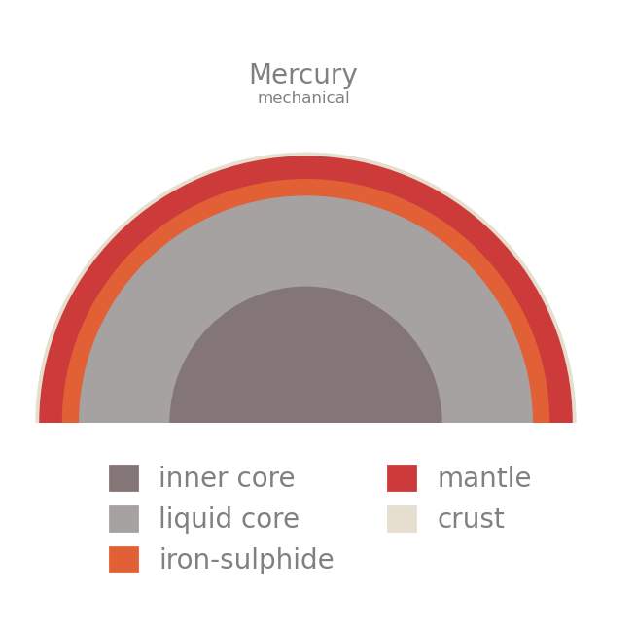
Lithospheres
Smaller planets which cool faster or have cooled already have thicker and stronger lithospheres.
This means they have less geological activity.
Notes:
Here all layers outside the core are solid part of the ‘lithospheric mantle’

Slide 9
Lithospheres
When planets cool stresses form in the lithosphere leading to geological activity like rifts, earthquakes etc.
Out-gassing from the rocks creates the atmosphere!
Notes:
Here all layers outside the core are solid part of the ‘lithospheric mantle’

Slide 10
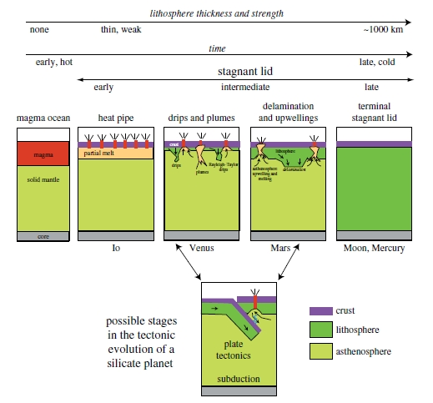
Robert J. Stern:
The Evolution of Plate Tectonics
Notes:
Planets which are further along in their cooling evolution have less active surfaces volcanically and tectonically.

Slide 11
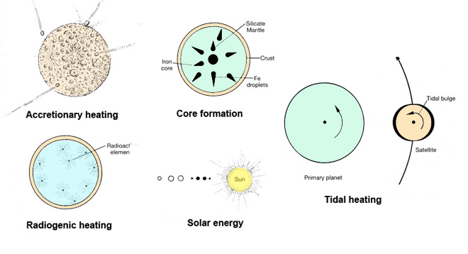
Eric H Christiansen
Notes:
We’re talking about loosing heat – here are 5 ways we can gain heat – after formation accretionary and core formation become negligible.

Slide 12
Quick Recap
Planets which cool quickly have thin/thick lithospheres.
A thinner lithosphere means the planet has more …
Differentiation caused…
Notes:
Thick
Geological activity
The heavier materials to fall to the centre of the planet

Slide 13
Surface Processes
Impact Cratering
Volcanism
Tectonics
Erosion
Notes:
Impact cratering: the blasting of bowl-shaped impact craters by asteroids or comets striking a planet’s surface.
Volcanism: the eruption of molten rock, or lava, from a planet’s interior onto its surface.
Tectonics: the disruption of a planet’s surface by internal stresses.
Erosion: the wearing down or building up of geological features by wind, water, ice, and other phenomena of planetary weather.

Slide 14
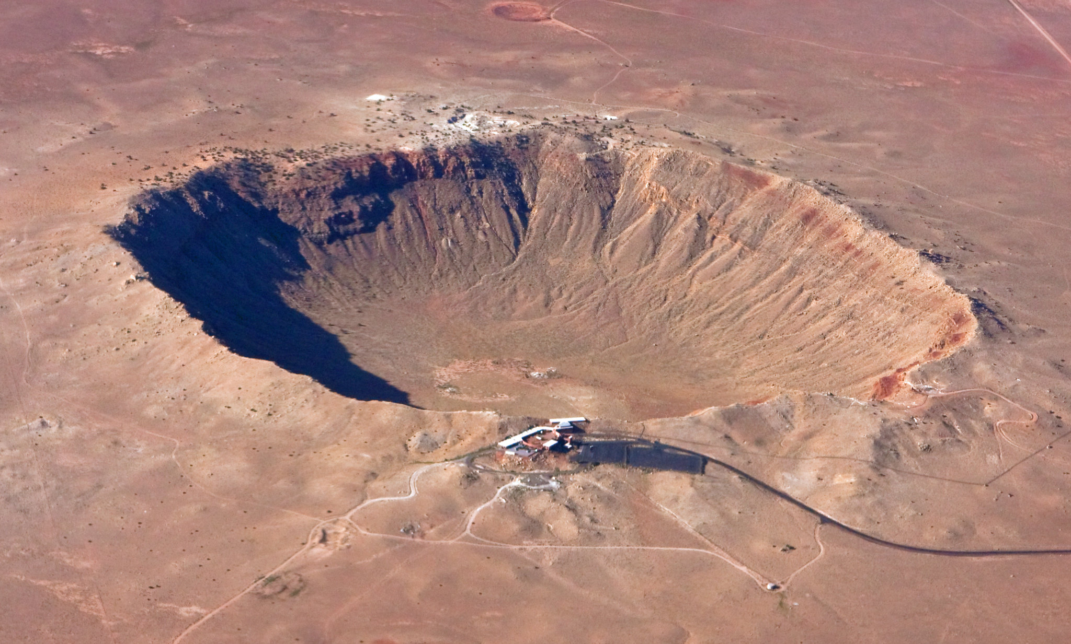
Impact Cratering
Erik Charlton
Notes:
Meteor Crater in Arizona https://www.flickr.com/photos/erikcharlton/7405663654/

Slide 15
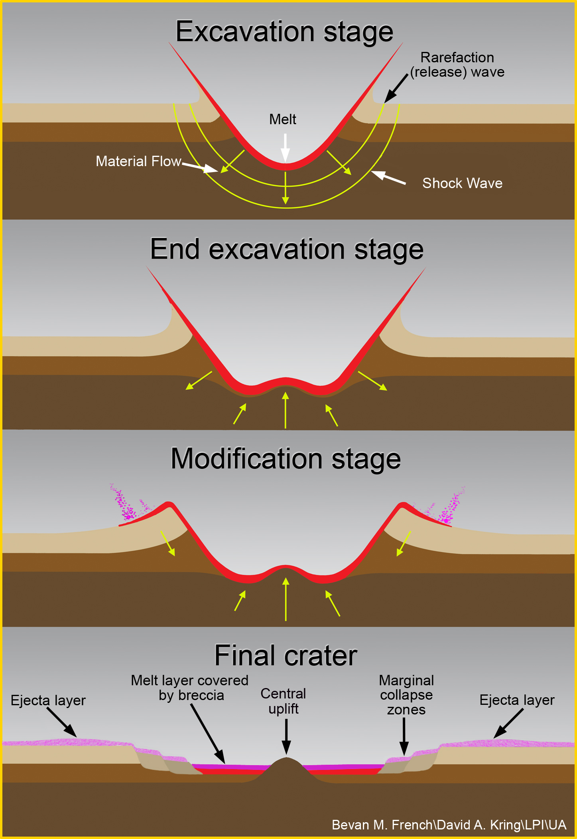
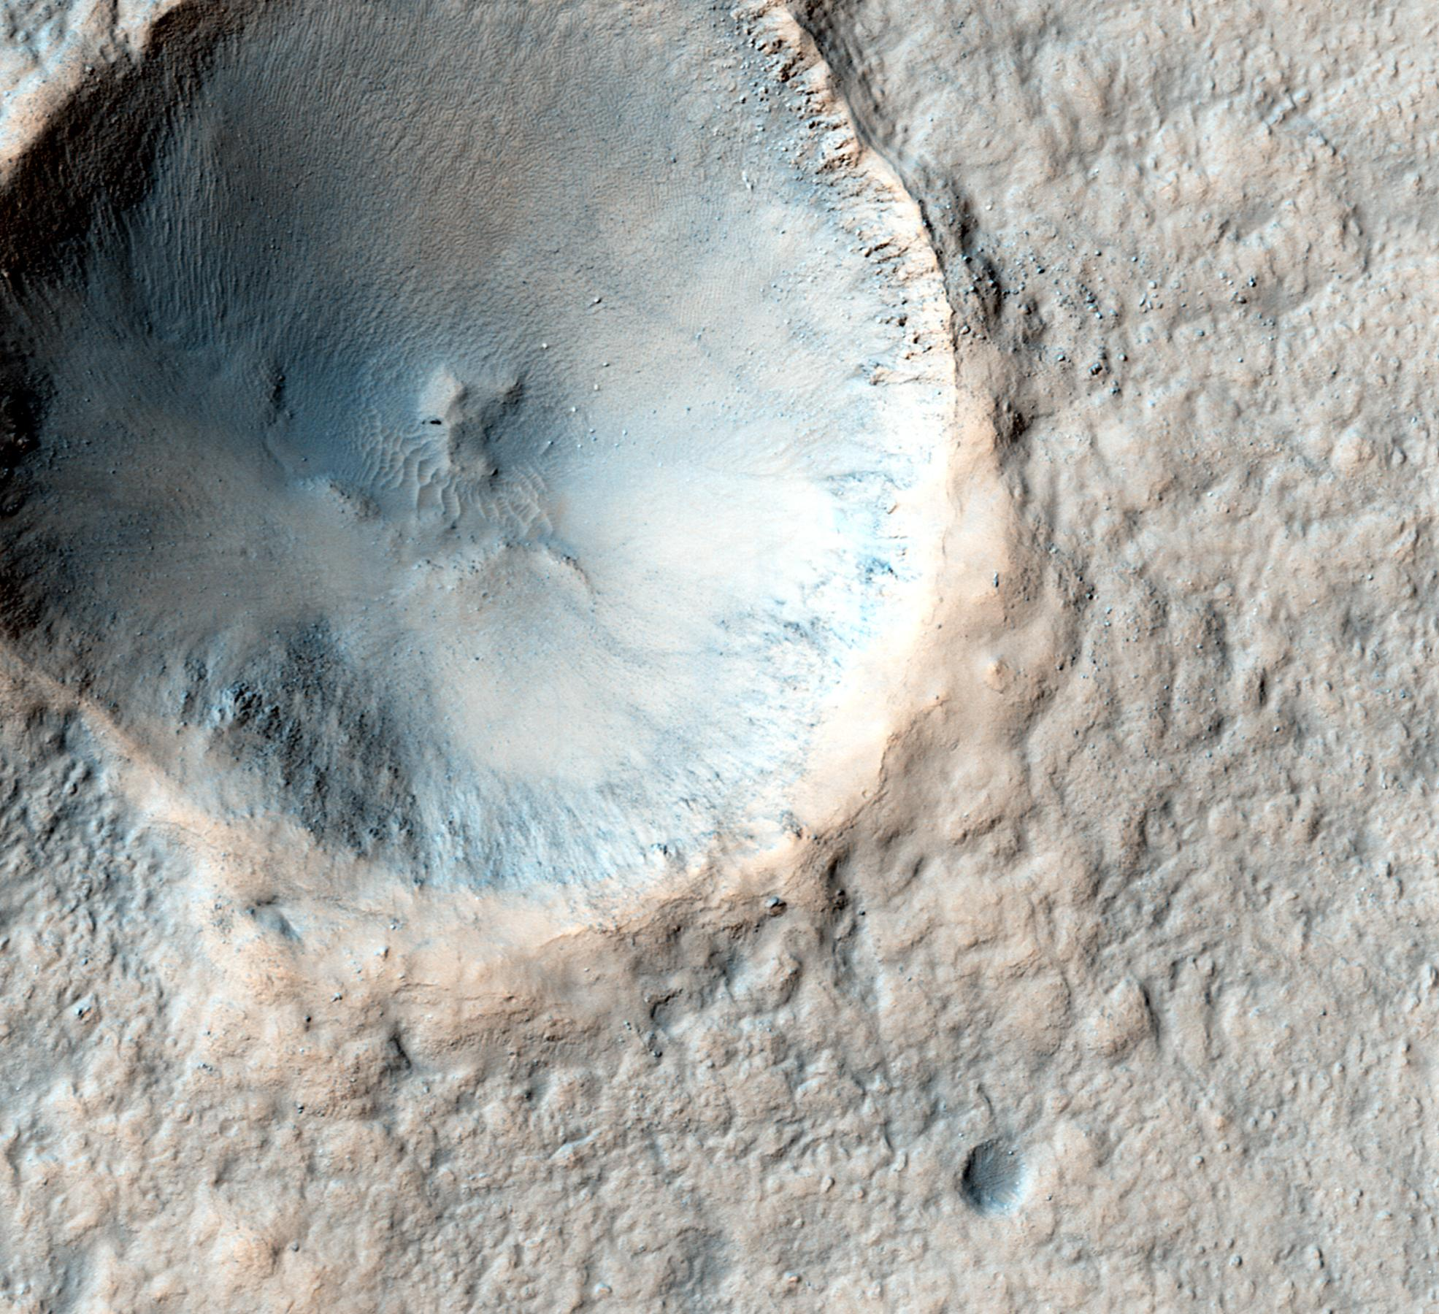
NASA/JPL-Caltech/Univ. of Arizona
Notes:
https://www.lpi.usra.edu/exploration/training/illustrations/craterFormation/
Image of a pedestal crater on Mars where the ejecta is eroding slower than the surroundings since it is harder
https://www.jpl.nasa.gov/spaceimages/details.php?id=PIA19849

Slide 16
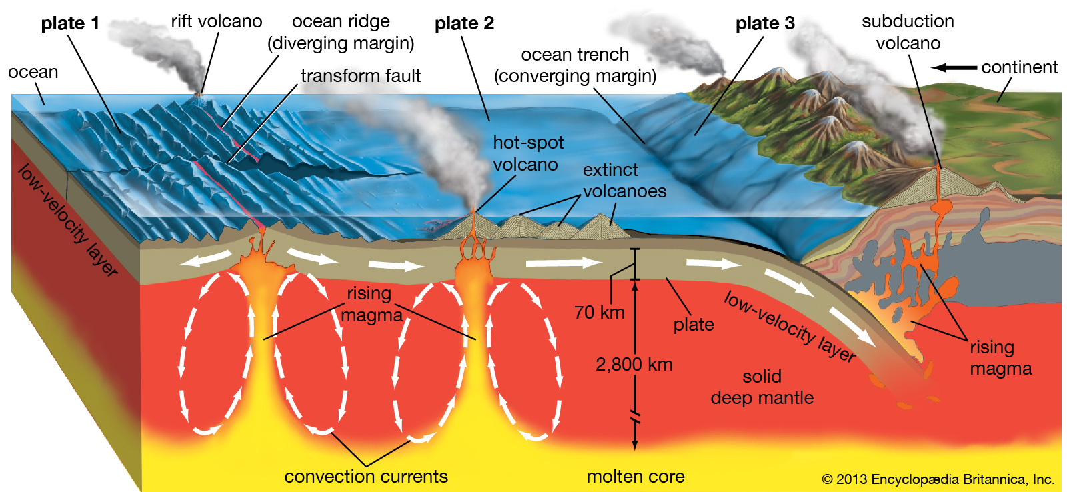
Volcanism

Slide 17
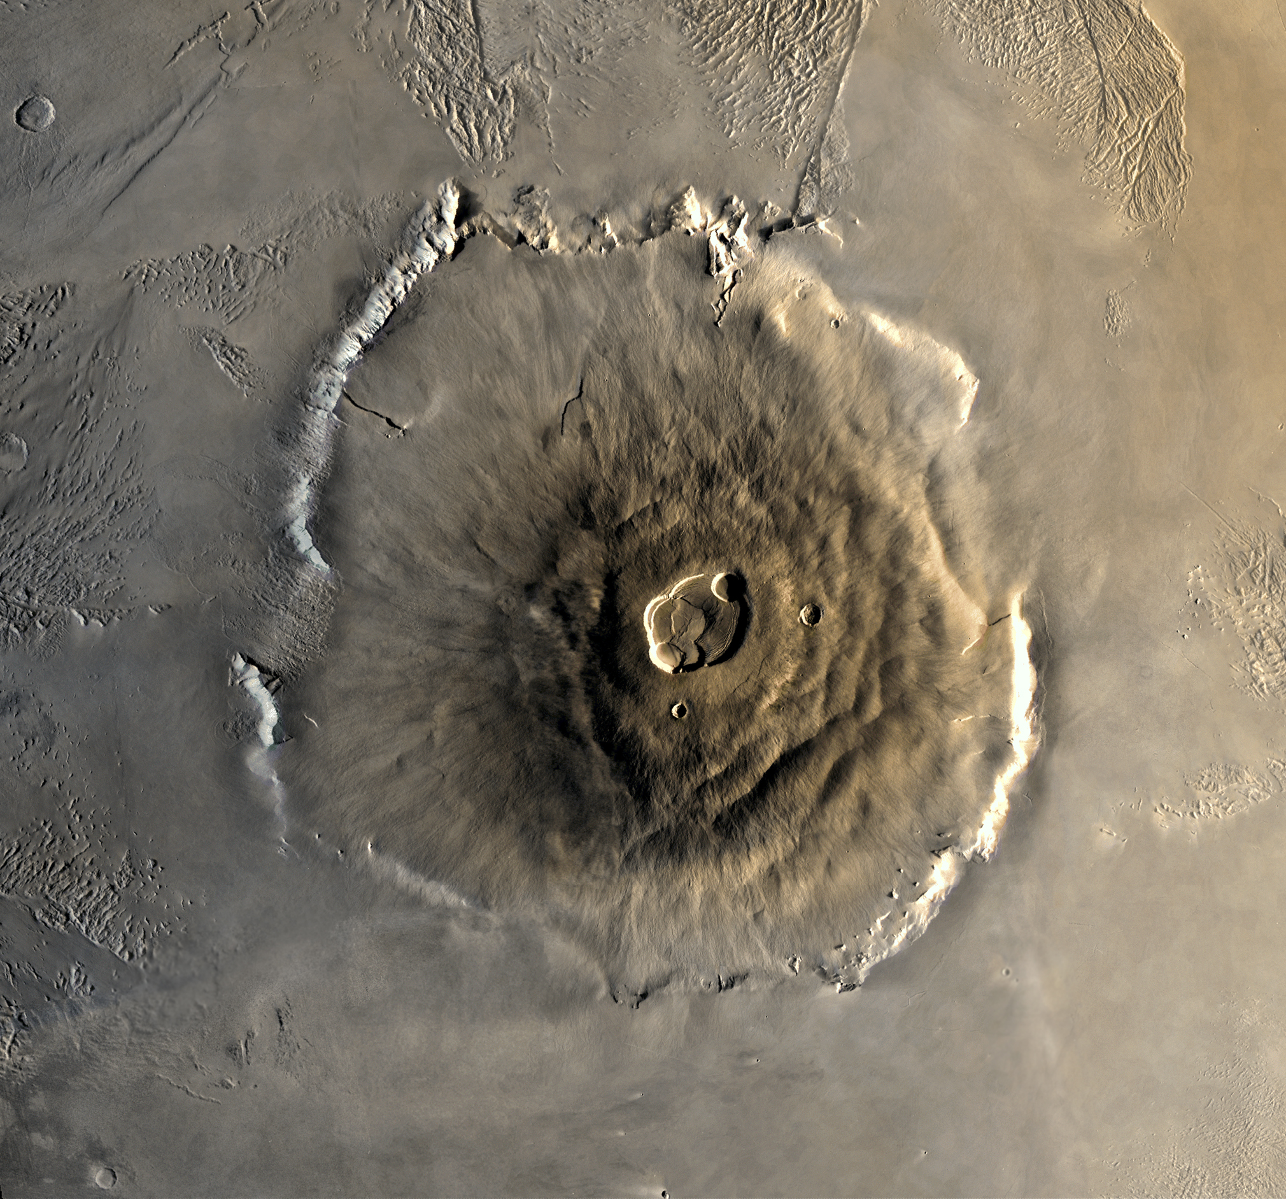
NASA/Seddon - wikimedia
Notes:
This image is a mosaic of Olympus Mons. The mosaic was created with the medium-resolution black and white MDIM combined with a low resolution color image mosaic acquired on the 735 orbit of Viking 1 on June 22, 1978. The central edifice of Olympus Mons has a summit caldera 24 km above the surrounding plains. Surrounding the volcano is an outward-facing scarp 550 km in diameter and several kilometres high. Beyond the scarp is a moat filled with lava, most likely derived from Olympus Mons. Farther out is an aureole of characteristically grooved terrain, just visible at the top of the frame. Image Processing by Jody Swann/Tammy Becker/Alfred McEwen, using the PICS (Planetary Image Cartography System) image processing system developed at the U.S. Geological Survey in Flagstaff, Arizona.

Slide 18
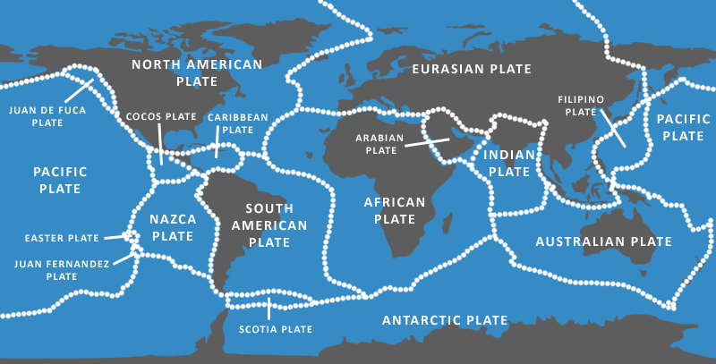
Tectonics
Whatarethe7continents.com

Slide 19
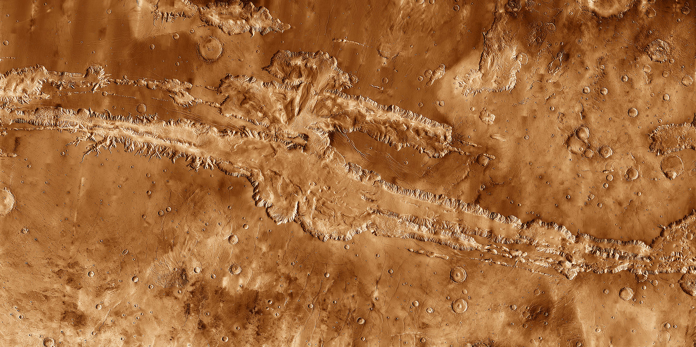
Notes:
Valles marineris
Ridge from previous tectonic activity / cooling stresses?
IR Image - http://themis.asu.edu/vallesspecial

Slide 20
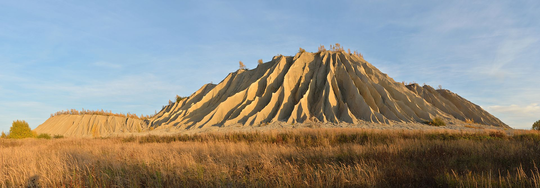
Erosion
Surface processes that remove material from one location and move them to another.
Can be done by wind, ice, water, sand etc. It is most significant on planets with substantial atmospheres, flowing water/ice.
Ivar Leidus
Notes:
Ivar Leidus https://en.wikipedia.org/wiki/Erosion#/media/File:Rummu_aherainem%C3%A4gi2.jpg
Image shows gullies on a soil tip from mining formed by rainfall.

Slide 21
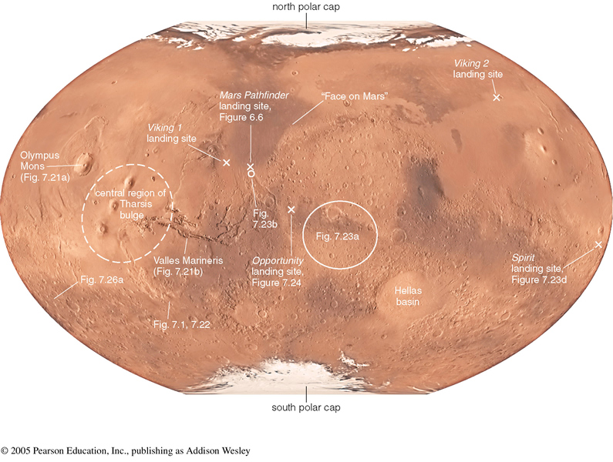
Geology of Mars
The Martian surface is like Earth’s desert and volcanic plains.
Joshua E. Barnes
Notes:
High elevation and numerous large impact craters in the southern hemisphere
Lower elevation and few impact craters in the northern hemisphere
Volcanism is the most likely mechanism responsible for changing the surface features of Mars.
Adapted from slides by Joshua E Barnes

Slide 22
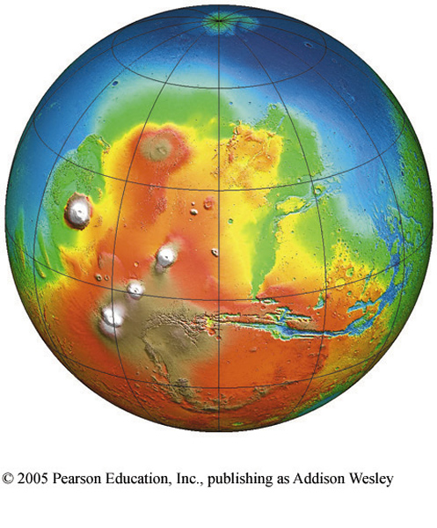
Ancient Martian Ocean?
Mars might have had an ocean covering the lower blue areas in the elevation map on the right.
Joshua E. Barnes
Notes:
Adapted from slides by Joshua E Barnes

Slide 23
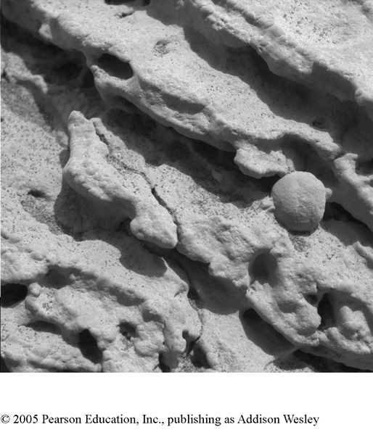
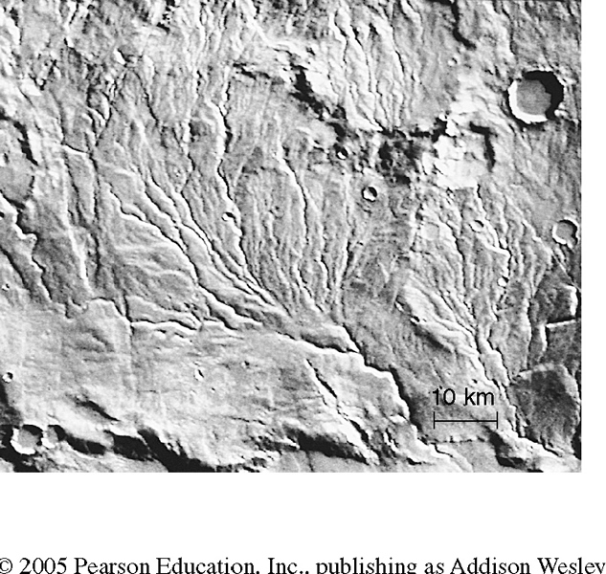
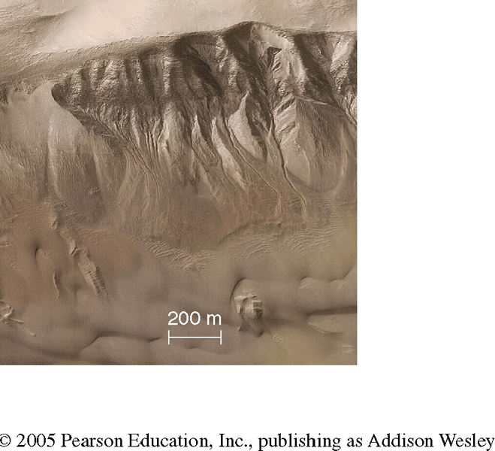
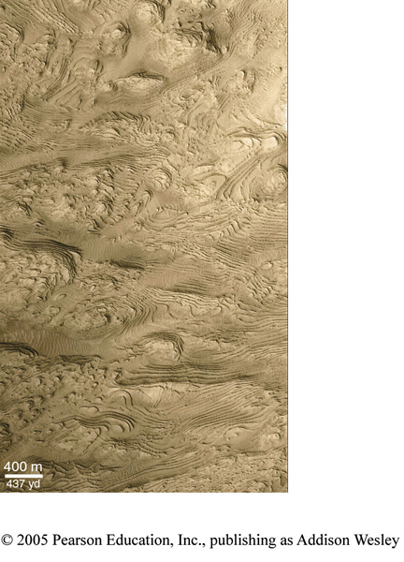
Water on Mars in the Past?
Riverbed?
Images from Mars Rover Spirit at a suspected ancient lake site showed rock structures consistent with those formed from sediments in standing water
Gullies?
Lake Bottom?
Joshua E. Barnes
Notes:
Many features are associated with water on Earth
Adapted from slides by Joshua E Barnes

Slide 24
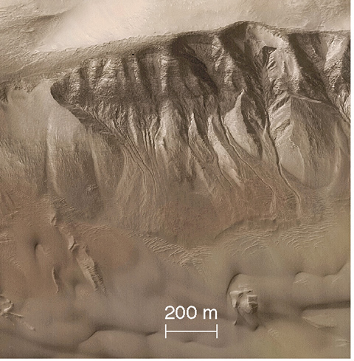
Water on Mars Today?
“Gullies form when snow accumulates on crater walls in winter and then melts away in spring. Because the gullies are relatively small, they should be gradually covered over by blowing sand during Martian dust storms. Thus, gullies that are still clearly visible must be no more than a few million years old. Geologically speaking, this time is short enough to make it quite likely that water flows are still forming gullies today.”
Pearson Education
Notes:
Adapted from slides by Joshua E Barnes

Slide 25
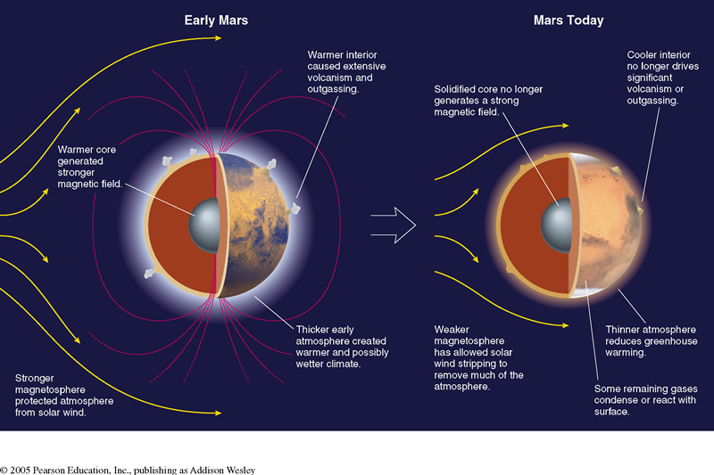
Why doesn’t Mars have water today?
If Mars used to hold a large amount of water, then why is Mars so different today? What caused it to lose its water?
Notes:
Adapted from slides by Joshua E Barnes
The smaller size of Mars means that it cools off faster. Once it cools, volcanic activities stop, halting the release of gases into the atmosphere.
The cool interior temperature may means that Mars does not have a fluid metallic core to generate magnetic fields anymore.
Without a magnetosphere, the atmosphere is exposed to the bombardment of high energy charged particles of solar wind, which break the air molecules, making them easier to escape.
As Mars cools, the remaining CO₂ gases are frozen in the north and south pole, forming the ice cap.
The remaining oxygen are trapped on surface rock, making it look red

Slide 26
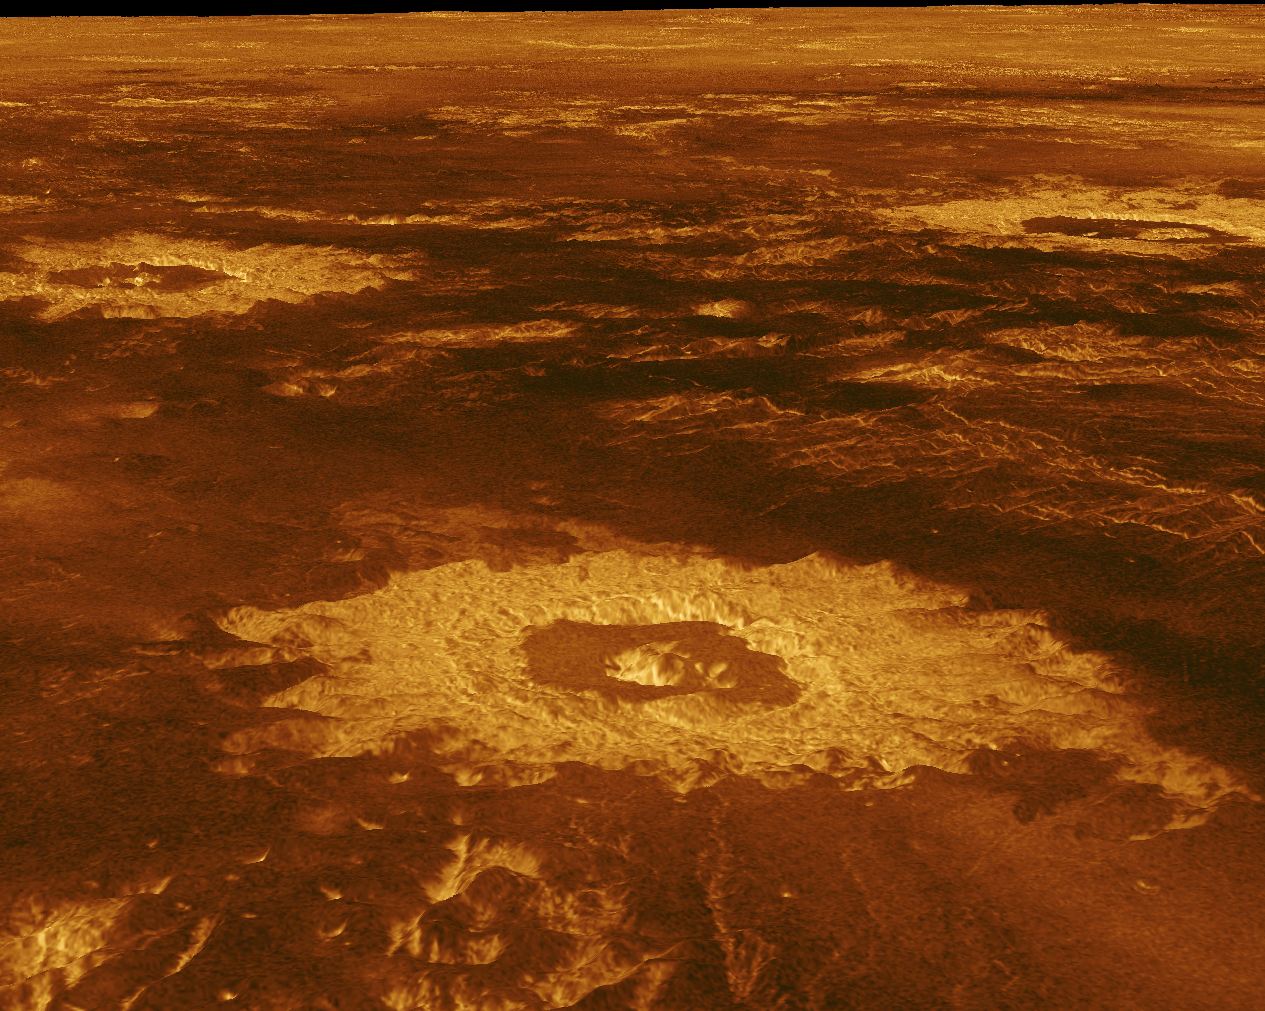
Geology of Venus
NASA/JPL
Notes:
NASA/JPL https://solarsystem.nasa.gov/resources/477/the-crater-farm/
Adapted from slides by Joshua E Barnes
Venus’ surface is similar to Earth and Mars – few impact craters, volcanoes, and evidence of tectonics activities…
But no plate tectonics
The volcanoes of Venus is most likely still active today
few impact craters,
sulfuric acid cloud (the volcanoes are still outgasing)
However, there is no sign of erosion
No liquid water?
No wind, due to its slow rotation (243 Earth days per rotation).
Venus dos not have a magnetic field!
This is quite surprising given that most of the ingredients required for the dynamo are all present…

Slide 27
Why doesn’t Venus have water?
Given the similarities between Earth and Venus, why is the atmosphere of Venus so different from Earth’s?
Venus is too hot!
The proximity to the Sun keep the temperature on Venus high, even without greenhouse effect. Any water on Venus (from out-gassing of water trapped inside the planet) are vaporized into gaseous phases (water vapor).
Water vapor and CO₂ are both greenhouse gas, causing the atmosphere to warm up more ⇒ runaway greenhouse effect ⇒ T = 740 ºK
At 740 ºK, the molecules of gases has much higher average kinetic energy (recall the definition of temperature) ⇒ higher average velocity.
If the velocity of the gas molecules exceed the escape velocity, then they can escape into space…
Light gases (H, H₂O, O₂, N₂) escape, heavy gases (CO₂) stay. Why?
Without liquid water, CO₂ doesn’t have a place to go, except to stay in the atmosphere…in comparison, most of the CO₂ on Earth are locked in rock or liquid water...
Notes:
Adapted from slides by Joshua E Barnes

Slide 28
Recap
What surface process dominates on Mars? Why?
What surface process dominates on Venus? Why?
What is the main source of heat for the Earth?

Slide 29
Kepler’s Laws & Gravity
Up next:

